Slide 1
INTRODUCTION TO BIG DATA ANALYTICS

Slide 2
Contents
History of Hadoop-Hadoop use cases,
Distributed File system
HDFS architecture
The Design of HDFS
Name node and data node
Blocks and replication management
Rack awareness
HDFS Federation
Anatomy of File write
Anatomy of File read.

Slide 3
Hadoop
Hadoop is an open-source software framework used for storing and processing Big Data in a distributed manner on large clusters of commodity hardware.
Hadoop is licensed under the Apache v2 license.
Hadoop was developed, based on the paper written by Google on the MapReduce system and it applies concepts of functional programming.
Hadoop is written in the Java programming language and ranks among the highest-level Apache projects.
Hadoop was developed by Doug Cutting and Michael J. Cafarella.

Slide 4
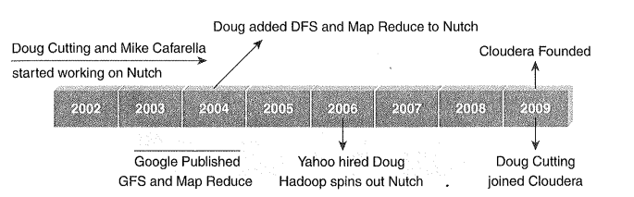
History of Hadoop

Slide 5
USE CASE OF HADOOP
The ClickStream analysis using Hadoop provides three key benefits:
Hadoop helps to join ClickStream data with other data sources such as Customer Relationship Management Data (Customer Demographics Data, Sales Data, and Information on Advertising Campaigns). This additional data often provides the much needed information to understand cus­tomer behavior.
Hadoop's scalability property helps you to store years of data without ample incremental cost. This helps you to perform temporal or year over year analysis on Click Stream data which your competitors may miss.
Business analysts can use Apache Pig or Apache Hive for website analysis. With these tools, you can organize ClickStream data by user session, refine it, and feed it to visualization or analytics tools.

Slide 6
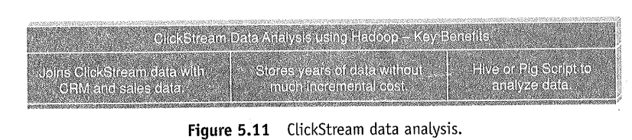
USE CASE OF HADOOP
ClickStream data (mouse clicks) helps you to understand the purchasing behavior of customers.
ClickStream analysis helps online marketers to optimize their product web pages, promotional content, etc. to improve their business.

Slide 7
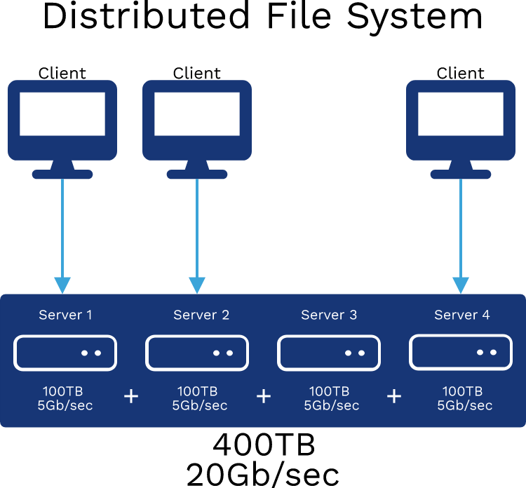
Distributed File System
A distributed file system (DFS) is a file system that is distributed on various file servers and locations.
It permits programs to access and store isolated data in the same method as in the local files.
It also permits the user to access files from any system.
It allows network users to share information and files in a regulated and permitted manner. Although, the servers have complete control over the data and provide users access control.

Slide 8
Distributed File System
DFS's primary goal is to enable users of physically distributed systems to share resources and information through the Common File System (CFS).
It is a file system that runs as a part of the operating systems. Its configuration is a set of workstations and mainframes that a LAN connects.

Slide 9
Distributed File System
DFS has two components in its services, and these are as follows:
Local Transparency
It is achieved via the namespace component.
Redundancy
It is achieved via a file replication component.
In the case of failure or heavy load, these components work together to increase data availability by allowing data from multiple places to be logically combined under a single folder known as the "DFS root".
It is not required to use both DFS components simultaneously; the namespace component can be used without the file replication component, and the file replication component can be used between servers without the namespace component.

Slide 10
Working of Distributed File System
There are two methods of DFS in which they might be implemented, and these are as follows:
1. Standalone DFS namespace
It does not use Active Directory and only permits DFS roots that exist on the local system.
A Standalone DFS may only be acquired on the systems that created it.
It offers no-fault liberation and may not be linked to other DFS.
2. Domain-based DFS namespace
It stores the DFS configuration in Active Directory and creating namespace root at
domainname>dfsroot> or
FQDN>dfsroot>

Slide 11
Applications of Distributed File System
There are several applications of the distributed file system. Some of them are as follows:
Hadoop
Hadoop is a collection of open-source software services.
It is a software framework that uses the MapReduce programming style to allow distributed storage and management of large amounts of data.
Hadoop is made up of a storage component known as Hadoop Distributed File System (HDFS). It is an operational component based on the MapReduce programming model.
NFS (Network File System)
A client-server architecture enables a computer user to store, update, and view files remotely.
It is one of various DFS standards for Network-Attached Storage.

Slide 12
Applications of Distributed File System
SMB (Server Message Block)
IBM developed an SMB protocol to file sharing.
It was developed to permit systems to read and write files to a remote host across a LAN.
The remote host's directories may be accessed through SMB and are known as "shares".
NetWare
It is an abandon computer network operating system that is developed by Novell, Inc.
The IPX network protocol mainly used combined multitasking to execute many services on a computer system.

Slide 13
Hadoop Distributed File System
Apache HDFS or Hadoop Distributed File System is a block-structured file system where each file is divided into blocks of a pre-determined size.
These blocks are stored across a cluster of one or several machines. Apache Hadoop HDFS Architecture follows a Master/Slave Architecture, where a cluster comprises of a single NameNode (Master node) and all the other nodes are DataNodes (Slave nodes).
HDFS can be deployed on a broad spectrum of machines that support Java. Though one can run several Data Nodes on a single machine, but in the practical world, these Data Nodes are spread across various machines.

Slide 14
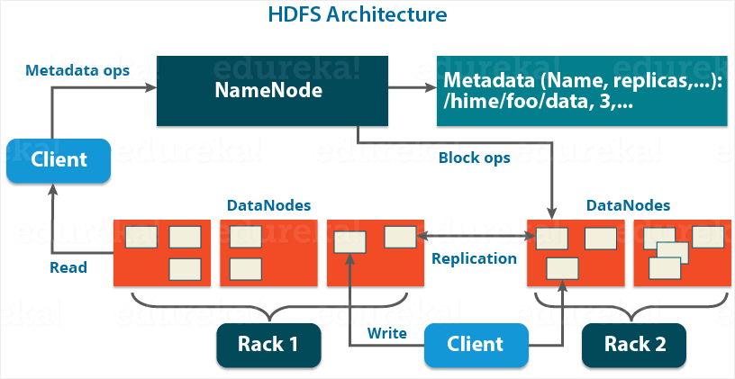

Slide 15
Hadoop Distributed File System
Name Node
Name Node is the master node in the Apache Hadoop HDFS Architecture that maintains and manages the blocks present on the Data Nodes (slave nodes).
Name Node is a very highly available server that manages the File System Namespace and controls access to files by clients.
The HDFS architecture is built in such a way that the user data never resides on the Name Node.
The data resides on Data Nodes only.

Slide 16
Hadoop Distributed File System
Data Node
Data Nodes are the slave nodes in HDFS.
Unlike Name Node, Data Node is a commodity hardware, that is, a non-expensive system which is not of high quality or high-availability.
The Data Node is a block server that stores the data in the local file ext3 or ext4.

Slide 17
Hadoop Distributed File System
Functions of Data Node
These are slave daemons or process which runs on each slave machine.
The actual data is stored on Data Nodes.
The Data Nodes perform the low-level read and write requests from the file system’s clients.
They send heartbeats to the Name Node periodically to report the overall health of HDFS, by default, this frequency is set to 3 seconds.

Slide 18
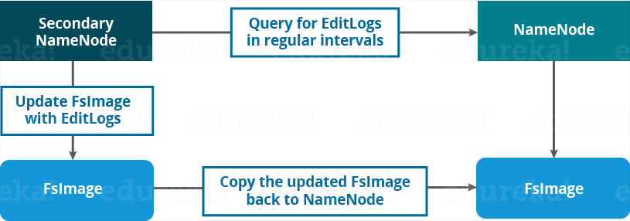
Hadoop Distributed File System
Secondary Name Node:
Apart from these two daemons, there is a third daemon or a process called Secondary Name Node.
The Secondary Name Node works concurrently with the primary Name Node as a helper daemon.
Secondary Name Node is not being a backup Name Node.

Slide 19
Hadoop Distributed File System
Functions of Secondary Name Node:
The Secondary Name Node is one which constantly reads all the file systems and metadata from the RAM of the Name Node and writes it into the hard disk or the file system.
It is responsible for combining the EditLogs with FsImage from the Name Node.
It downloads the EditLogs from the Name Node at regular intervals and applies to FsImage. The new FsImage is copied back to the Name Node, which is used whenever the Name Node is started the next time.
Hence, Secondary Name Node performs regular checkpoints in HDFS. Therefore, it is also called Checkpoint Node.

Slide 20
Blocks
Blocks are the nothing but the smallest continuous location on your hard drive where data is stored.
In general, in any of the File System, you store the data as a collection of blocks.
Similarly, HDFS stores each file as blocks which are scattered throughout the Apache Hadoop cluster.
The default size of each block is 128 MB in Apache Hadoop 2.x (64 MB in Apache Hadoop 1.x) which you can configure as per our requirement.

Slide 21
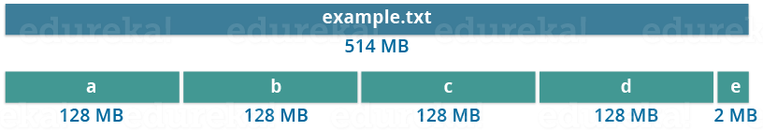
Blocks
It is not necessary that in HDFS, each file is stored in exact multiple of the configured block size (128 MB, 256 MB etc.).
Let’s take an example where I have a file “example.txt” of size 514 MB as shown in above figure.
Suppose that we are using the default configuration of block size, which is 128 MB. Then, how many blocks will be created? 5, Right.
The first four blocks will be of 128 MB. But, the last block will be of 2 MB size only.

Slide 22
Blocks
Well, whenever we talk about HDFS, we talk about huge data sets, i.e. Terabytes and Petabytes of data.
So, if we had a block size of let’s say of 4 KB, as in Linux file system, we would be having too many blocks and therefore too much of the metadata.
So, managing these no. of blocks and metadata will create huge overhead, which is something, we don’t want.

Slide 23
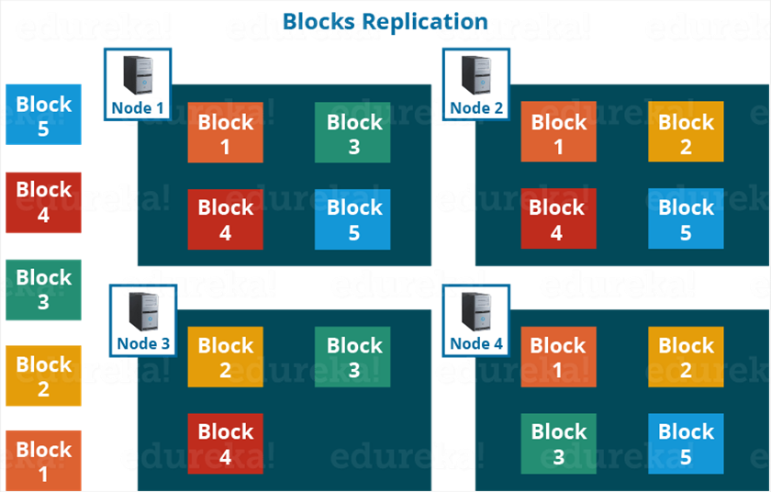
Replication Management
HDFS provides a reliable way to store huge data in a distributed environment as data blocks.
The blocks are also replicated to provide fault tolerance.
The default replication factor is 3 which is again configurable.
So, as you can see in the figure below where each block is replicated three times and stored on different Data Nodes (considering the default replication factor):

Slide 24
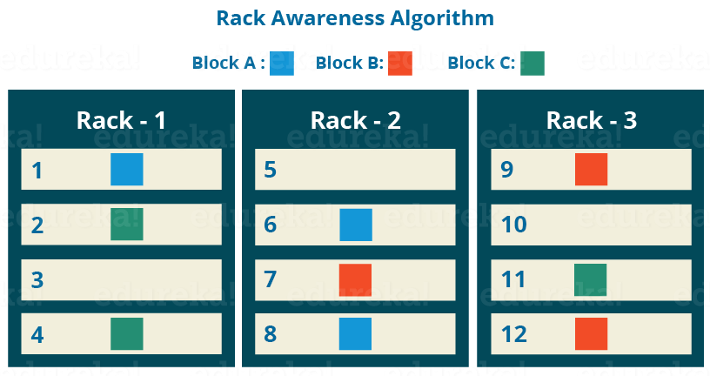
Rack Awareness

Slide 25
Rack Awareness
The Name Node also ensures that all the replicas are not stored on the same rack or a single rack.
It follows an in-built Rack Awareness Algorithm to reduce latency as well as provide fault tolerance.
Considering the replication factor is 3, the Rack Awareness Algorithm says that the first replica of a block will be stored on a local rack and the next two replicas will be stored on a different (remote) rack but, on a different Data Node within that (remote) rack as shown in the figure above.
If we have more replicas, the rest of the replicas will be placed on random Data Nodes provided not more than two replicas reside on the same rack, if possible.
This is how an actual Hadoop production cluster looks like. Here, we have multiple racks populated with Data Nodes:

Slide 26
Rack Awareness
Advantages of Rack Awareness
To improve the network performance
The communication between nodes residing on different racks is directed via switch.
In general, you will find greater network bandwidth between machines in the same rack than the machines residing in different rack.
So, the Rack Awareness helps you to have reduce write traffic in between different racks and thus providing a better write performance.
Also, you will be gaining increased read performance because you are using the bandwidth of multiple racks.

Slide 27
Rack Awareness
To prevent loss of data
We don’t have to worry about the data even if an entire rack fails because of the switch failure or power failure.
And if you think about it, it will make sense, as it is said that never put all your eggs in the same basket.

Slide 28
Limitations of Hadoop 1.0 Architecture
In Hadoop 1.0, HDFS and MapReduce are Core Components, while other components are built around the core.
Single Name Node is responsible for managing entire namespace for Hadoop Cluster.
It has a restricted processing model which is suitable for batch-oriented MapReduce jobs.
Hadoop MapReduce is not suitable for interactive analysis.
Hadoop 1.0 is not suitable for machine learning algorithms, graphs, and other memory intensive algorithms.
MapReduce is responsible for duster resource management and data processing
In this Architecture, map slots might be "full", while the reduce slots are empty and vice versa. This causes resource utilization issues. This needs to be improved for proper resource utilization.

Slide 29
Limitations of Hadoop 1.0 Architecture
HDFS Limitation
Name Node saves all its file metadata in main memory.
Although the main memory today is not as small and as expensive as it used to be two decades ago, still there is a limit on the number of objects that one can have in the memory on a single Name Node.
The Name Node can quickly become overwhelmed with load on the system increasing.
In Hadoop 2.x, this is resolved with the help of HDFS Federation.

Slide 30
Hadoop 2: HDFS
Hadoop 2: HDFS
HDFS 2 consists of two major components: (a) namespace, (b) blocks storage service. Namespace service takes care of file-related operations, such as creating files, modifying files, and directories.
The block storage service handles data node cluster management, replication.
HDFS 2 Features
Horizontal scalability.
High availability

Slide 31
HDFS Federation
HDFS Federation uses multiple independent Name Nodes for horizontal scalability.
Name Nodes are independent of each other.
It means, Name Nodes does not need any coordination with each other. The Data Nodes are common storage for blocks and shared by all Name Nodes.
All Data Nodes in the cluster registers with each Name Node in the cluster.
High availability of Name Node is obtained with the help of Passive Standby Name Node.

Slide 32
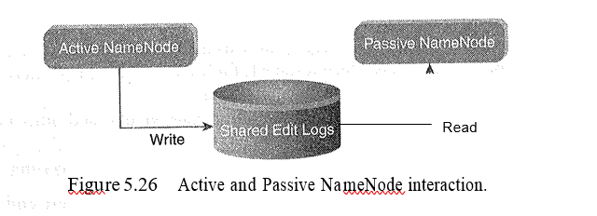
HDFS Federation
In Hadoop 2.x, Active-Passive Name Node handles failover automatically.
All namespace edits are recorded to a shared NFS Storage and there is a single writer at any point of time.
Passive Name Node reads edits from shared storage and keeps updated metadata information.
In case of Active Name Node failure, Passive Name Node become an Active Name Node automatically.
Then it starts writing to the shared storage.

Slide 33
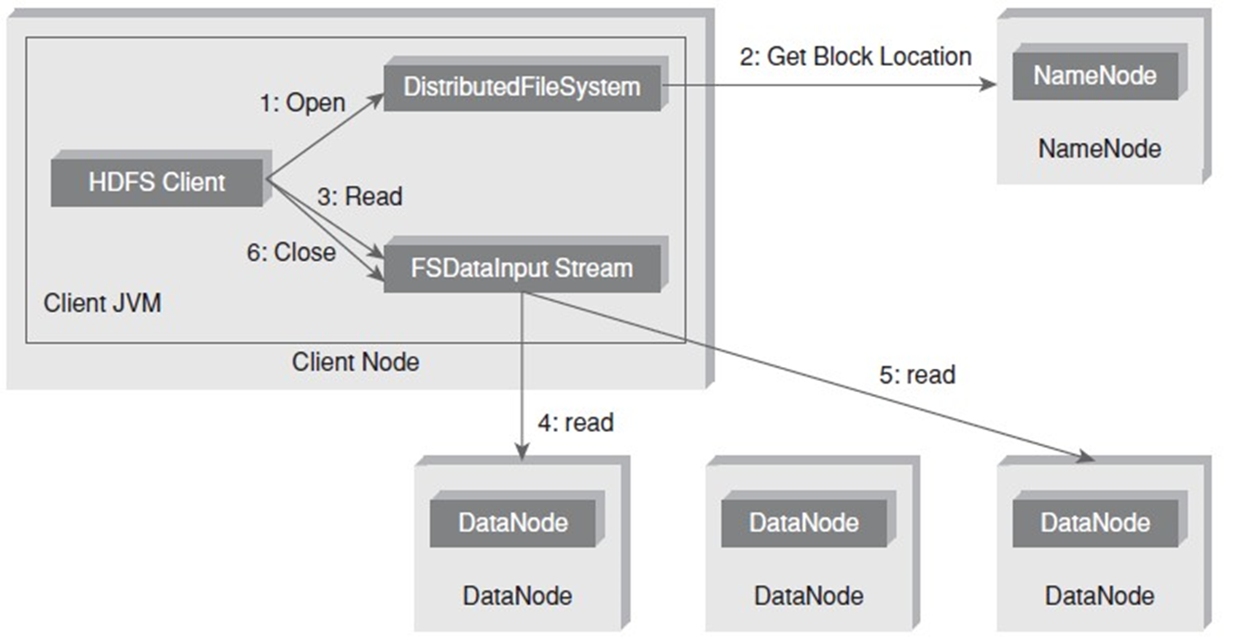
Anatomy of File Read

Slide 34
Anatomy of File Read
The steps involved in the File Read are as follows:
The client opens the file that it wishes to read from by calling open() on the Distributed File System.
Distributed File System communicates with the Name Node to get the location of data blocks. Name Node returns with the addresses of the Data nodes that the data blocks are stored on. Subsequent to this, the Distributed File system returns an FS Data lnput Stream to client to read from the file.
Client then calls read() on the stream DFSlnputStream, which has addresses of the Data nodes for the first few blocks of the file, connects to the closest Data node for the first block in the file.
Client calls read() repeatedly to stream the data from the Data node.
When end of the block is reached, DFSlnputStream closes the connection with the Datanode. It repeats the steps to find the best Data node for the next block and subsequent blocks.
When the client completes the reading of the file, it calls close() on the FSDatalnputStream to close the connection.

Slide 35
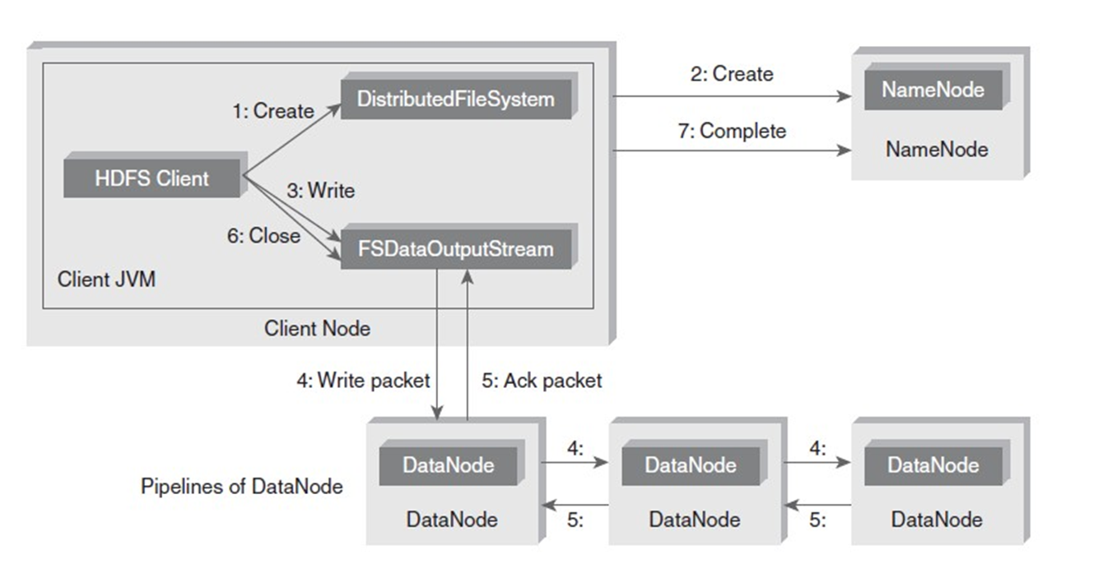
Anatomy of File Write

Slide 36
Anatomy of File Write
The steps involved in anatomy of File Write are as follows:
The client calls create() on Distributed File System to create a file.
An RPC call to the Name Node happens through the Distributed File System to create a new file. The Name Node performs various checks to create a new file (checks whether such a file exists or not). Initially, the Name Node creates a file without associating any data blocks to the file. The Distributed File System returns an FSDataOutputStream to the client to perform write.
As the client writes data, data is split into packets by DFSOutputStream, which is then written to an internal queue, called data queue. Data Streamer consumes the data queue. The DataStreamer requests the Name Node to allocate new blocks by selecting a list of suitable Data nodes to store replicas. This list of Data nodes makes a pipeline. Here, we will go with the default replication factor of three, so there will be three nodes in the pipeline for the first block.

Slide 37
Anatomy of File Write
DataStreamer streams the packets to the first Data node in the pipeline. It stores packet and forwards it to the second Data node in the pipeline. In the same way, the second Data node stores the packet and forwards it to the third Data node in the pipeline.
In addition to the internal queue, DFSOutputStream also manages an "Ack queue" of packets that are waiting for the acknowledgement by Data nodes. A packet is removed from the "Ack queue" only if it is acknowledged by all the Data nodes in the pipeline.
When the client finishes writing the file, it calls close() on the stream.
This flushes all the remaining packets to the Data node pipeline and waits for relevant acknowledgments before communicating with the Name Node to inform the client that the creation of the file is complete.

